Slide 1

HRD Facilities Master Plan Project
HRD Board Meeting
January 11, 2022

Slide 2
Project objectives
Prioritize upgrades of the Highlands pool and pool house and extends useful life of existing buildings and grounds
Identifies facility and grounds improvements where feasible to better meet programming and operational needs and identifies new community spaces like the MPR
Identifies viable funding mechanisms
Responsive to community needs
Phased approach with preliminary work directed by staff
Notes:
To provide a facility master plan which prioritizes the upgrades of the Highlands pool and pool house, extends useful life of existing buildings and grounds, makes improvements where feasible to better meet programming needs, identifies viable funding mechanisms and is responsive to community needs.
Master Planning / Space Programming will involve developing concepts on how to improve the pool spaces for aquatic programming, identify new community spaces like the MPR, and tie any proposed facility upgrades into the larger Rec facility and grounds.
Phased Approach with preliminary work directed by staff and will establish a foundation for a comprehensive master plan document.

Slide 3
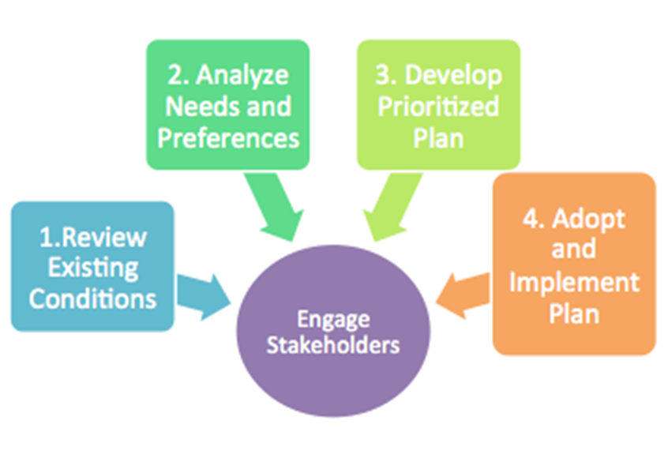
Facilities Master Plan

Slide 4
Phase 1 – Existing conditions
Update facility asset schedule that includes current replacement and cost information
Identify all facility and grounds deferred maintenance and repairs
Recommendations for corrective measures and cost estimates provided
Identify facility structures and systems requiring further inspection and analysis
Develop a capital improvement plan (CIP) for projects greater than $25K
Narrative summary of existing conditions to be included in plan

Slide 5
Phase 2 – Facility needs and preferences
HRD Facilities Master Plan Advisory Committee
Community Survey
Project web page
Stakeholder meetings and focus groups
Notes:
HRD Master Plan Advisory Committee will:
Identify areas we are good at, improvements needed and missed opportunities
Review existing conditions, previous reports and studies
Facility tours of the Rec
Look at other facilities (pools) to generate ideas and concepts to consider
Help prioritize improvements and concepts
Community Survey
Provide analysis of existing programs and facilities
Identify areas for improvement, prioritize needs and improvements
Identify areas not served or underserved
Stakeholder groups – Get input on specific aspects of plan, confirm and validate, gain support

Slide 6
Phase 3 – Prioritized action plan
Key findings summarized in plan
Matrix of projects that includes priority ranking and order of magnitude costs estimates
Concepts developed and ranked based on community input
5-year capital improvement plan for ongoing and future capital projects
Notes:
Action plan will be developed based on an analysis of existing conditions, community needs assessment etc.

Slide 7
Phase 4 – Funding
COPs and future borrowing capacity
General Bond
Capital Improvement Plan
Friends of the Rec foundation
Notes:
This process will answer the following questions:
How big of a project are we talking about?
What are the givens for any large-scale project?
What viable funding mechanisms are available to the District?
CIP
The District’s CIP is a 5-year planning document which identifies the major capital improvement expenditures and gives a proposed sequence of implementing their construction. The CIP is reviewed and revised annually to account for completed and newly identified projects.
Prefunding capital projects with CIP fund to plan, transfers into fund
Prioritization criteria (health/safety, protection of infrastructure, impacts on operating budgets, capacity, cost benefit, available financing

Slide 8

Timeline
Notes:
Proposed project schedule and deliverables are included in staff report. The project is broken up in phases but it is expected that the phases / components will overlap as needed. Early work will focus on existing conditions analysis while we gear up for the community engagement component. The community engagement will inform the plan’s priorities and development of an action plan. Phase 4 (funding) can occur concurrently with the rest of the work.

